Slide 1


Lists, Arrays & Dictionaries
PYTHON BASICS
Three ways to store data in Python
Notes:
Welcome. Today we meet the three most-used containers in Python: the list, the NumPy array and the dictionary. Each slide shows the syntax, a short code example and its output. Ask students to type each example themselves in Google Colab as you go.

Slide 2
List
PART 1 · LISTS
Definition: a list is an ordered, changeable collection of items inside square brackets.
Lists are built-in data types in Python used to store collections of data
Lists are used to store multiple items in a single variable.
Python basics · Lists

Slide 3
Lists: items in order
PART 1 · LISTS
70
85
90
65
index 0
index 1
index 2
index 3
marks = [70, 85, 90, 65]
print(marks[0]) # 70
# 65 (last item)
print(marks[1:3]) # [85, 90]
print(len(marks)) # 4
marks[1] = 88 # [70, 88, 90, 65]
Counting starts at 0. The slice stops before the stop index.
Python basics · Lists

Slide 4

List methods: add, remove, sort, loop
PART 1 · LISTS
fruits = ["apple", "banana"]
fruits.append("orange") # add to end
fruits.insert(1, "mango") # add at index 1
fruits.remove("banana") # delete by value
for f in fruits: # loop
print(f)
THE LIST AFTER EACH STEP
append → ['apple', 'banana', 'orange']
insert → ['apple', 'mango', 'banana', 'orange']
remove → ['apple', 'mango', 'orange']
loop → prints apple, then mango
A list can store different types of data.
Python basics · Lists

Slide 5
NumPy arrays
PART 2 · ARRAYS
Definition: An array can hold many values under a single name.
Python Array allows us to store multiple elements of the same data type in an orderly collection.
Index Number: You refer to an array element by referring to the index number.
Python basics · Arrays

Slide 6
NumPy arrays: fast maths on numbers
PART 2 · ARRAYS
import numpy as np
a = np.array([2, 4, 6, 8])
print(a * 2) # [ 4 8 12 16]
print(a + 10) # [12 14 16 18]
print(a.mean()) # 5.0
print(a.shape) # (4)
print(np.arange(1, 6)) # [1 2 3 4 5]
Python basics · Arrays

Slide 7
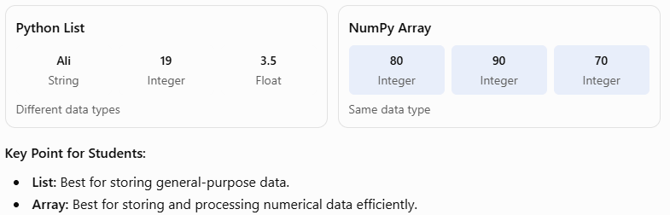
List Vs Array

Slide 8
Dictionaries: labelled values
PART 3 · DICTIONARIES
student = {"name": "Ali", "age": 19, "gpa": 3.5}
print(student["name"]) # Ali
student["age"] = 20 # update a value
student["city"] = "Lahore" # add a new pair
del student["gpa"] # delete a pair
for key, value in student.items():
print(key, value)
SYNTAX
d = {key: value}
d[key]
d[key] = value
del d[key]
LOOP PRINTS
name Ali
age 20
city Lahore
Python basics · Dictionaries
Notes:
student.items() returns the key-value pairs.
key stores the current key, such as "name".
value stores its corresponding value, such as "Ali".
The loop runs once for each key-value pair. The for loop automatically terminates when all key-value pairs in the dictionary have been visited.

Slide 9
List, array or dictionary?
PART 4 · CHOOSING
 | List | NumPy array | Dictionary
Brackets | [ ] | np.array([ ]) | { }
Stores | Any items in order | Numbers for fast maths | Key: value pairs
Access by | Position: x[0] | Position: x[0] | Key: x["name"]
Best for | Names, to-do items | Marks, temperatures | A student record
Python basics · Choosing

